Slide 1
GEO-INFORMATICS Lecture # 2: Geospatial data capturing
Data Capturing Methods

Slide 2
Data: The Fuel
The geographic data are information abut the earth’s surface and the objects are found on it.
Data are fuel to a GIS. How can we feed data such as map into a GIS?.
Data capture (collection) is the process of putting information into the system.
A wide variety of sources can be used for creating geographic data

Slide 3
GIS Data Collection
Data collection is a time consuming, tedious, and expensive GIS activity.
Typically it accounts for 15–50% of the total cost of a GIS project.
If staff costs are excluded from a GIS budget, then in cash expenditure terms data collection can be as much as 60–85% of costs.
The processes of data collection are also referred to as data capture, data automation, data conversion, data transfer, data translation, and digitizing.

Slide 4
Types and Sources of geographic data
Geographic data generally are available in two forms: analogue and digital data
Analogue data are physical product displaying information visually on paper, e.g. maps.
Digital data are information in a computer-readable form, e.g. satellite data.
There are various source for obtaining these type of data. These includes maps, aerial photographs, satellite images, existing tabular data (in analogue and digital format) and field data (GPS).
All of these sources can be grouped as primary or secondary sources

Slide 5
Types and Sources of geographic data
Two main types of data sources are:
Primary data sources : Those collected in digital format specifically for use in a GIS project.
Secondary data sources: Digital and analog datasets that were originally captured for another purpose and need to be converted into a suitable digital format for use in a GIS project

Slide 6
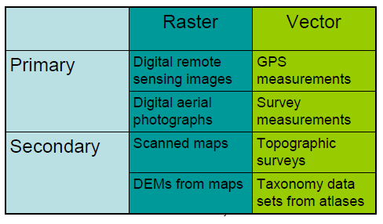
Types and Sources of geographic data

Slide 7
Data capturing methods:
a) Vector data capture: This includes
Keyboard entry, digitizing, field surveying,

Slide 8
Keyboard entry
Involve reading or obtaining the coordinates of point features from maps or other source documents, typing the coordinates into a file in a tabular format, and reading the file into the GIS
In some GIS systems, point features are also called XY events
Used when the number of point features is small

Slide 9
Digitizing
Involve choosing geographical features from the map or image, and manually tracing the features along their boundaries or shapes one by one using a digitizer while recording the coordinates of the points selected to approximate the boundary or shape of each feature
Tablet and on-screen digitizing

Slide 10
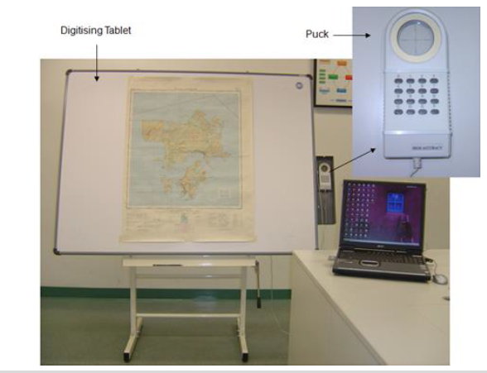
Digitizing tablet

Slide 11
On-screen digitizing
Scan the source document into a digital image if a paper map or aerial photo is used
Add the image into a GIS
Georeference the image
Trace features on the image using the mouse
Edit features
Add attribute data

Slide 12
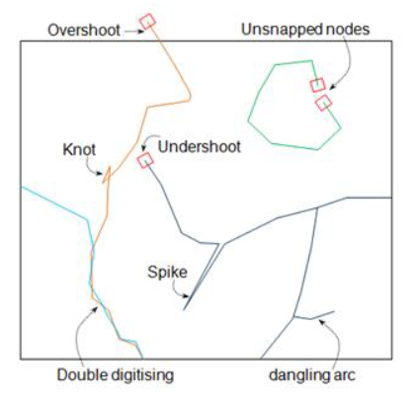
Typical digitizing errors

Slide 13
Field surveying
Collect spatial data through direct measurements in the field
Traditionally, precision triangulation, trilateration, traversing and geometric levelling with plane tables, transits and theodolites
More recently, total stations and GNSS

Slide 14
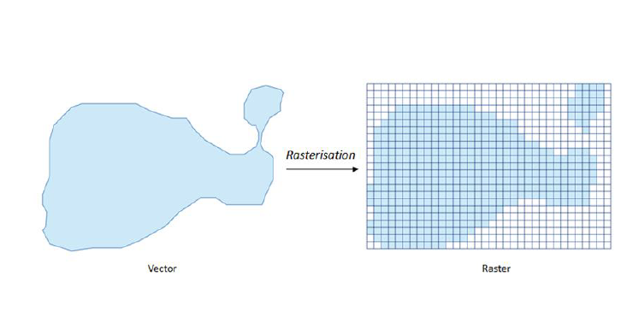
Raster data capture
Remotely sensed images, including satellite images and aerial photographs directly imported as raster data into GIS
Rasterisation: vector-to-raster conversion
Rasterisation: loss of information

Slide 15
Crowdsourcing
Collect spatial data by soliciting contributions from the community or general public
•Involve the use of the Internet-enabled and location-aware mobile devices to gather location-specific information
•Three key technologies
•the Web, geotagging and mobile computing

Slide 16
Activity:
Download OSM data (use: http://download.geofabrik.de/africa/tanzania.html (Use Qgis (exercise))
Download data from SDI and internet
Downloads satellite images: (use: https://earthexplorer.usgs.gov/)
Read and try these also: https://gisgeography.com/free-satellite-imagery-data-list/

Slide 17
Spatial data transfer
Import existing digital spatial data from external sources
may be in different data formats
read directly, or
translated into a suitable format

Slide 18
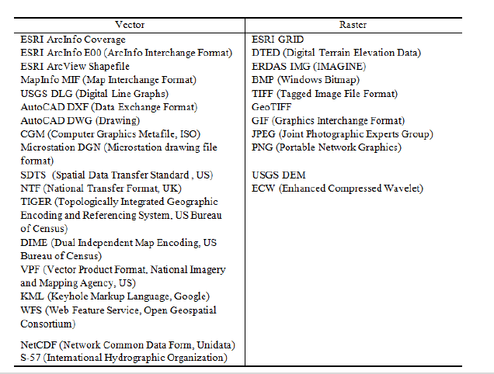
Digital spatial data formats

Slide 19
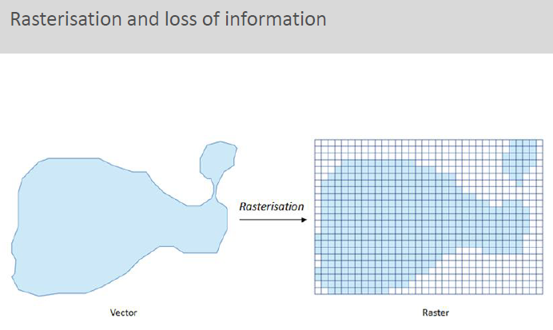
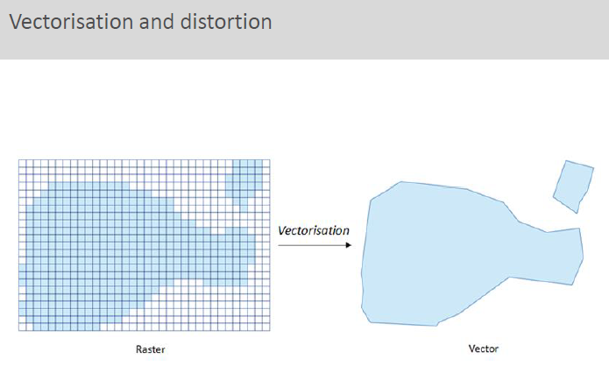
Spatial data transformation
Data structure conversion
Geometric transformation
Line simplification
Edge matching

Slide 20
Spatial data editing
To remove the errors that arise during the encoding of spatial data
location errors
Topological errors
Attribute data errors

Slide 21
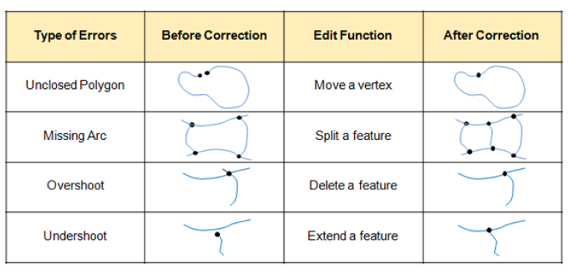
Editing individual features

Slide 22
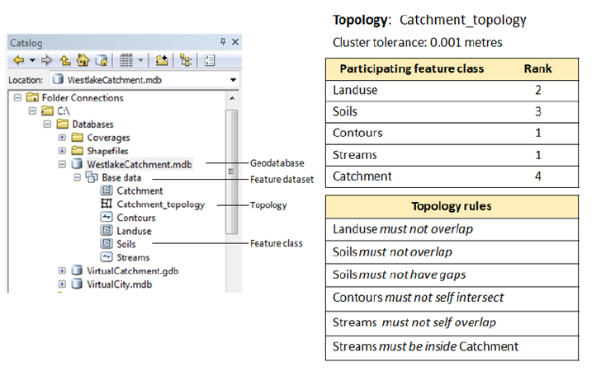
Editing with topology rules

Slide 23
Editing attribute data
Attribute data may contain observational or measurement errors, data entry errors or are simply out of date
Editing includes adding, deleting, or updating attributes associated with features and their values

Slide 24
THANKS:
ANY QUESTION ??

